Slide 1
Programming fundamentals
Lecture 12: 2D arrays, char arrays and strings

Slide 2
Recap
Basic idea of multi-dimensional arrays
Finding element in an array
Sorting
Working of cin

Slide 3
Agenda
2D arrays
Char array
Strings

Slide 4
Copying one array A to another array B
#include<iostream>
using namespace std;
int main()
{
int A[5],B[5];
for (int i = 0; i < 5; i++)
{
cin[ >> A[i];
}
for (int i = 0; i < 5; i++)
{
B[i]=A[i];
}
for (int i = 0; i < 5; i++)
{
cout << "A: " << A[i] << " ";
cout << "B: " << B[i];
cout << endl;
}
return 0;
}

Slide 5
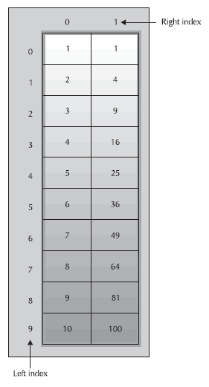
2D array
#include<iostream>
using namespace std;
int main()
{
int sqrs1[10][2] = {1, 1,2, 4,3, 9,4, 16,5, 25,6, 36,7, 49,8, 64,9, 81,10, 100};
int sqrs2[10][2] = {{1, 1},{2, 4},{3,9},
{4, 16},{5, 25},{6, 36},{7, 49},{8, 64},{9, 81},{10, 100}};
return 0;
}
Two Ways to initialize 2D arrays

Slide 6
Example
#include<iostream>
using namespace std;
int main()
{
const int rows = 2; const int cols = 2;
int arr[rows][cols] = {1,2,3,4};
for (int i = 0; i < rows; i++)
{
for (int j = 0; j < cols; j++)
{
cout << arr[i][j] << " ";
}
cout << endl;
}
return 0;
}
0
1
1 | 2
3 | 4
0
1
[0][0] | [0][1]
[1][0] | [1][1]

Slide 7
#include<iostream>
using namespace std;
int main()
{
const int rows = 3; const int cols = 4;
int arr[rows][cols];
for (int i = 0; i < rows; i++)
{
if(i==0)
{
for (int j = 0; j < cols; j++)
cin >> arr[i][j];
cout << endl;
}
}
for (int i = 0; i < rows; i++)
{
for (int j = 0; j < cols; j++)
{
cout << arr[i][j] << "\t";
}
cout << endl;
}
return 0;
}
0
1
2
3
1 | 2 | 3 | 4
0
1
2

Slide 8
String vs char array
A character array is simply an array of characters can terminated by a null character.
A string is a class which defines objects that be represented as stream of characters.
Size of the character array has to allocated statically, more memory cannot be allocated at run time if required. Unused allocated memory is wasted in case of character array.
In case of strings, memory is allocated dynamically. More memory can be allocated at run time on demand. As no memory is preallocated, no memory is wasted.
Implementation of character array is faster than std:: string. Strings are slower when compared to implementation than character array.
Character array do not offer much inbuilt functions to manipulate strings. String class defines a number of functionalities which allow manifold operations on strings.

Slide 9
char array
#include<iostream>
using namespace std;
int main()
{
char a1[5];
for (int i = 0; i < 5; i++)
cin>>a1[i];
for (int i = 0; i < 5; i++)
cout << "index " << i << " " << a1[i] << endl;
return 0;
}

Slide 10
Char array can also act as a string
In C++, a string is defined as a character array that is terminated by a null.
A null character is specified using '\0’.
Because of the null terminator, it is necessary to declare a character array to be one character longer than the largest string that it will hold.
char str[11];
Specifying the size as 11 makes room for the null at the end of the string.
Note: the string data type that we briefly covered is not the same as this character array. When we write “string name;” we are actually creating an object of string class built-in and defined in standard c++ library.
We will cover string class in a separate lecture. So, ignore it for now.

Slide 11

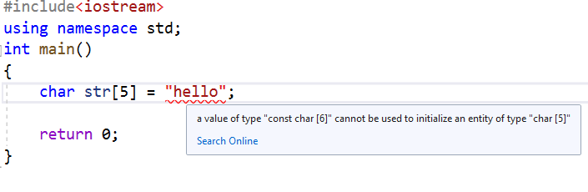
Strings or char array
0 1 2 3 4 5
char str[6] = "hello";
This is the same as writing
char str[6] = { 'h', 'e', 'l', 'l', 'o', '\0' };
If we use character array as a string and initialize it with a string, then we must consider a space for ‘\0’ character. Otherwise, compiler will generate an error. Like in this example, hello is of 5 characters so you need to declare a char array of 6 size. One extra cell for ‘\0’ character.

Slide 12
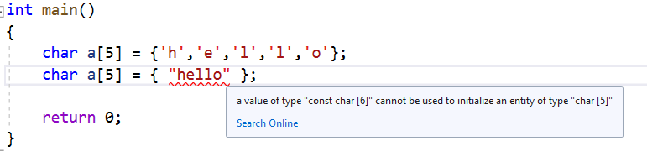
Alternative ways of defining a string
char str[4] = "C++";
char str[] = {'C','+','+','\0'};
char str[4] = {'C','+','+','\0'};
For initialization using curly brackets, we cannot put string inside braces, this is not allowed. For example, see the code below.
#include<iostream>
using namespace std;
int main()
{
char a[5] = {'h','e','l','l','o'};
char a[5] = { "hello" };
return 0;
}

Slide 13
#include<iostream>
using namespace std;
int main()
{
char str[5];
cin >> str;
cout << str;
return 0;
}
If we want to use character array as a string, then there is no need to append square brackets with the name of array.
Note: for int, double, bool, and other data types, array name depicts base address. But in case of char array, the array name does not act as a base address.
Like in this example, we have declared an array of 5 characters. Thus, it is mandatory for user to enter only 4 characters (4 plus 1 for ‘\o’). If the user enters “hello” which is 5 characters long then the compiler will throw exception.

Slide 14
#include<iostream>
using namespace std;
int main()
{
char str[5];
cin >> str;
int i = 0;
while (1)
{
if (str[i++] == '\0’)
break;
}
return 0;
}
We can apply conditional logic on null terminator character to see if we reach the end of our character array or not. This will might help in designing a logic of “finding the number of characters in a string”
In this program, an infinite loop is created that keeps on accessing elements of an array one by one using statement str[i++]. We want to end the loop, once end of a character array is reached. Therefore we introduced if statement in it.

Slide 15
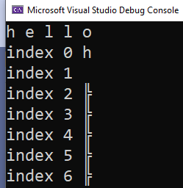
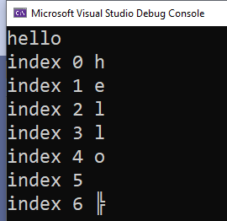
Giving input to char array in string form
Giving input to char array in characters form
#include<iostream>
using namespace std;
int main()
{
char a[6];
cin >> a;
for(int i=0;i<7;i++)
cout << "index "<<i<<" "<<a[i]<<endl;
return 0;
}
#include<iostream>
using namespace std;
int main()
{
char a[6];
cin >> a;
for (int i = 0; i < 7; i++)
cout << "index " << i << " " << a[i] << endl;
return 0;
}
Once you enter a space after character ‘h’, cin will assume that you have finished giving input. It thus stores ‘h’ to array. Any other characters that you write after that will be discarded. You will notice that by default the compiler places blanks and special characters into the empty places

Slide 16
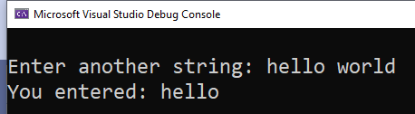
Char array takes a space as a terminating character
What if we want to have a sentence recorded in our char array
“Hello World” is taken as “Hello”… space is taken as terminating character
#include<iostream>
using namespace std;
int main()
{
char str[20];
cout << "\nEnter another string: ";
cin >> str;
cout << "You entered: " << str << endl;
return 0;
}
‘world’ is discarded because cin has taken space as a terminating character.

Slide 17
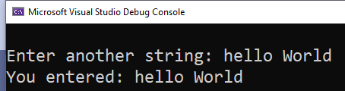
Solution to get a complete sentence as input in character array
Use getline function
Getline takes three arguments: 1) char array name, 2) number of characters to take from an input, 3) terminating character. Argument 3 is optional and if we don’t specify it then by default ‘\n’ newline character is assumed.
Now with getline, cin will either terminate when number of characters is reached, or when newline (ENTER) character is encountered.
#include<iostream>
using namespace std;
int main()
{
char str[20];
cout << "\nEnter another string: ";
cin.getline(str,20);
cout << "You entered: " << str << endl;
return 0;
}

Slide 18
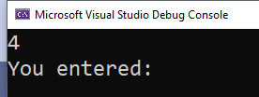
Contd..
Cin integer and then cin char array will cause ambiguous behavior
After you do cin>>t;, the buffer still contains the newline sequence. Then getline() reads an immediate newline which tricks it into thinking that the user just pressed enter without typing anything.
In order to fix this, you need to ignore the newline before calling getline().
#include<iostream>
using namespace std;
int main()
{
int x;
char str[6];
cin >> x;
cin.getline(str, 6,'\n');
cout << "You entered: " << str << endl;
return 0;
}
The program terminated without taking input in char array

Slide 19
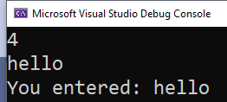
Contd..
#include<iostream>
using namespace std;
int main()
{
int x;
char str[6];
cin >> x;
cin.ignore();
cin.get(str, 6,'\n');
cout << "You entered: " << str << endl;
return 0;
}

Slide 20
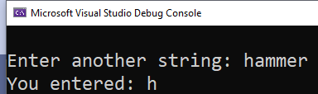
Contd..
It also allows a third argument that specifies the terminating character for input. The default value is the newline character.
Since ‘a’ is taken as a terminating character. Thus, once the user enters a, cin will stop taking further input. Like ‘a’ inserted after first ‘h’ in below example.
#include<iostream>
using namespace std;
int main()
{
char str[20];
cout << "\nEnter another string: ";
cin.getline(str, 20,'a');
cout << "You entered: " << str << endl;
return 0;
}

Slide 21
Practice problems character array

Slide 22
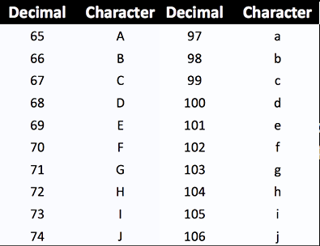
Changing a character from upper case to lower case
ASCII value of A is 65 and ASCII value of a is 97
65+32 = 97 = a = equivalent value of A in lowercase i.e., a
#include<iostream>
using namespace std;
int main()
{
char ch;
cout << "Enter a character in uppercase : ";
cin >> ch;
ch = ch + 32;
cout << "Character in lowercase = " << ch;
return 0;
}

Slide 23

Finding length of a string
#include<iostream>
using namespace std;
int main()
{
char str[100]; /* Declares a string of size 100 */
int l = 0;
cin >> str;
while (str[l] != '\0')
{
l++;
}
cout << "Length of the string is " << l;
return 0;
}

Slide 24

Reverse a string
Length: 5
U | S | A | M | A | \0
0 | 1 | 2 | 3 | 4 | 5
#include<iostream>
using namespace std;
int main()
{
char str[100];
int l = 0;
cin >> str;
while (str[l] != '\0')
{
l++;
}
for (int i = l-1; i >= 0; i--)
{
cout<<str[i];
}
return 0;
}

Slide 25
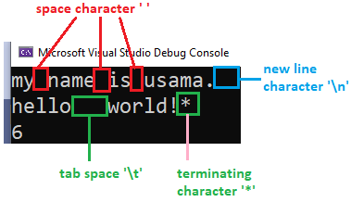

Count the total number of words in a string.
#include<iostream>
using namespace std;
int main()
{
char str[50];
int i, wrd;
cin.getline(str,50,'*');//considering * as a terminating character
i = 0;
wrd = 1;
while (str[i] != '\0')
{
if (str[i] == ' ' || str[i] == '\n' || str[i] == '\t')
wrd++;
i++;
}
cout<< wrd;
return 0;
}

Slide 26
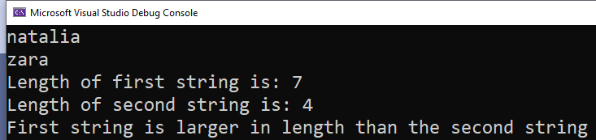
Compare two strings with respect to length
#include<iostream>
using namespace std;
int main()
{
char str1[10], str2[10]; /* Declares a string of size 100 */
int l1 = 0, l2 = 0; int i;
cin >> str1;
cin >> str2;
i = 0;
while (str1[i] != '\0')
{
l1++;i++;
}
cout << "Length of first string is: " << l1<<endl;
i = 0;
while (str2[i] != '\0')
{
l2++; i++;
}
cout << "Length of second string is: " << l2<<endl;
if (l1 == l2)
cout << "Both strings are equal";
else if (l1 > l2)
cout << "First string is larger in length than the second string";
else
cout << "First string is smaller in length than the second string";
return 0;
}

Slide 27
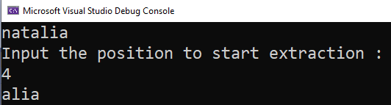
Extract a substring
#include<iostream>
using namespace std;
int main()
{
char str[10], sstr[10];
int pos, c = 0; int i; int l = 0;
cin >> str;
i = 0;
while (str[i] != '\0')
{
l++; i++;
}
cout<<"Input the position to start extraction :"<<endl;
cin>>pos;
while (c < l)
{
sstr[c] = str[pos- 1+c];
c++;
}
sstr[c] = '\0';
cout << sstr;
return 0;
}

Slide 28
Some more problems..
Copy one string into another string
Count total number of vowels
Extract a substring with starting position as x and ending position as y
Change the letters in input string from upper case to lower case

Slide 29
Practice problems String

Slide 30
String Concatenation
#include <string>
#include<iostream>
using namespace std;
int main()
{
string firstName = "Natalia ";
string lastName = "Chaudhry";
string fullName = firstName + lastName;
cout << fullName;
return 0;
}
+ operator helps in appending a character or a string

Slide 31
String Concatenation
Use append() function
#include <string>
#include<iostream>
using namespace std;
int main()
{
string firstName = "Natalia ";
string lastName = "Chaudhry";
string fullName = firstName.append(lastName);
cout << fullName;
return 0;
}

Slide 32
+ operator acts according to the situation
+ is used for both addition and concatenation
z will be 30
z will be ‘1020’
#include <string>
#include<iostream>
using namespace std;
int main()
{
int x = 10;
int y = 20;
int z = x + y;
cout << z;
return 0;
}
#include <string>
#include<iostream>
using namespace std;
int main()
{
string x = 10;
string y = 20;
string z = x + y;
cout << z;
return 0;
}

Slide 33

Find string length: use length()function
#include <string>
#include<iostream>
using namespace std;
int main()
{
string txt = "Natalia";
cout << "The length string is: " << txt.length();
return 0;
}

Slide 34
Access Strings
You can access the characters in a string by referring to its index number inside square brackets []
string myString = "Hello"; cout << myString[0]; // Outputs H
myString[0] = ’h';

Slide 35
Input in strings
cin considers a space (whitespace, tabs, etc) as a terminating character, which means that it can only display a single word (even if you type many words)
Cin.getline() function only works for char array as its first argument
Use another version of getline():
Getline(first argument, second argument);
First argument is cin
Second argument is string variable name

Slide 36

Input in strings
#include <string>
#include<iostream>
using namespace std;
int main()
{
string fullName;
cout << "Type your full name: ";
getline(cin, fullName);
cout << "Your name is: " << fullName;
return 0;
}

Slide 37
Reading
D.S Malik C++ Programming-From Problem Analysis to Program Design, Pg. 486 - Pg. 526, Chapter 9 Array and Strings
Walter savitch, problem solving with C++
Pg 425, multi-dimensional array basics

Slide 38
Recommended reads
Walter Savitch, Problem Solving with C++ The Object of Programming
Chapter 7, page 378, section 7.1

